Slide 1
Sourcing Strategies for Innovation: Make, Ally, or Buy
“Should a firm develop innovation internally, collaborate with others, or acquire external innovators?”
Notes:
Highlight that sourcing decisions are at the heart of corporate innovation strategy.

Slide 2
Learning Objectives
Explain the logic of Make, Ally, Buy sourcing strategies.
Apply Transaction Cost Economics (TCE) and Resource Dependency Theory (RDT) to innovation sourcing.
Analyze Meta’s acquisitions as examples of “Buy” strategy.
Evaluate when alliances outperform internal R&D or acquisitions.
Notes:
Clarify that this topic integrates strategic theory with modern digital platform realities.

Slide 3
Why Sourcing Strategy Matters
Innovation doesn’t occur in isolation. Firms must balance:
Speed vs. control
Capability development vs. dependency
Risk vs. opportunity
Short-term gains vs. long-term learning
Notes:
Teaching Note: Provide real-world context—discuss how Big Tech (Meta, Google, Amazon) faces the “build or buy” dilemma regularly.

Slide 4
The Make–Ally–Buy Spectrum
Strategy | Description | Key Question
Make | Internal R&D | “Can we build it ourselves?”
Ally | Partnerships, joint ventures | “Can we co-develop or share?”
Buy | Mergers, acquisitions | “Should we acquire instead?”

Slide 5
Theoretical Foundations
Transaction Cost Economics (TCE)
Firms internalize when market coordination is costly.
Resource Dependency Theory (RDT)
Firms collaborate or acquire to reduce dependence on external actors.
Strategic Fit Perspective
The right sourcing mode depends on the firm’s capabilities, uncertainty, and resource gaps.
Notes:
Briefly mention Ronald Coase and Oliver Williamson for TCE, and Pfeffer & Salancik for RDT.

Slide 6
Transaction Cost Economics (TCE)
Core Principles:
Markets and hierarchies both have costs.
Internal R&D avoids market opportunism but creates bureaucracy.
Outsourcing or alliances reduce overhead but increase coordination risk.
Notes:
Use example: When Intel vertically integrated semiconductor design and production to avoid supplier opportunism.

Slide 7
Resource Dependency Theory (RDT)
Key Assumptions:
Firms rely on others for critical resources (knowledge, technology, talent).
Alliances and acquisitions reduce dependency by internalizing or sharing control.
Goal:
Maintain strategic autonomy while accessing external expertise.
Notes:
Teaching Note: Discuss Apple’s chip production shift (from suppliers to internal M-series chips) as a dependency-reduction move.

Slide 8
“Make” Strategy: Internal R&D
Advantages:
Builds unique competencies.
Protects intellectual property.
Creates sustainable competitive advantage.
Challenges:
High cost and long lead time.
Risk of technological lock-in.
Requires strong absorptive capacity (Cohen & Levinthal).
Notes:
Teaching Note: Reference Schilling’s emphasis on learning curves and cumulative knowledge creation.

Slide 9
When “Make” Works Best
When innovation is core to the firm’s identity (e.g., Tesla’s battery R&D).
When knowledge is tacit and hard to transfer.
When speed is less important than proprietary control.
When the firm has R&D infrastructure and expertise.
Notes:
Teaching Note: Pose the question: “Why doesn’t every firm simply ‘make’ everything internally?”

Slide 10
“Ally” Strategy: Strategic Alliances
A formal or informal agreement to share resources, risks, and rewards in pursuit of innovation.
Types:
R&D consortia
Technology licensing
Co-development partnerships
Joint ventures
Notes:
Teaching Note: Highlight examples like Toyota–Panasonic EV battery alliance or IBM–Apple collaboration on enterprise apps.

Slide 11
Advantages of Alliances
Shared risk and investment.
Access to complementary skills or technologies.
Faster time to market.
Opportunity for organizational learning.
Notes:
Teaching Note: Relate to Schilling’s concept of learning races — alliances as opportunities to absorb external knowledge before partners do.

Slide 12
Challenges of Alliances
Knowledge leakage and imitation.
Conflict over intellectual property.
Cultural and governance mismatches.
Opportunistic behavior from partners.
Notes:
Teaching Note: Engage students: “How might Google protect itself in an alliance with a smaller AI startup?”

Slide 13
“Buy” Strategy: Acquisitions
When a firm purchases another company to access technology, talent, or market share.
Benefits:
Speed of entry.
Instant access to new capabilities.
Control over critical technologies.
Notes:
Teaching Note: Use Meta’s acquisition timeline as an entry point.

Slide 14
Risks of Acquisitions
Overvaluation of targets.
Integration and cultural clash.
Redundant R&D or talent loss.
Innovation suffocation post-merger.
Notes:
Teaching Note: Discuss AOL–Time Warner and Microsoft–Nokia as cautionary examples.

Slide 15
Make–Ally–Buy Decision Framework
Criteria | Make | Ally | Buy
Knowledge Tacitness | High | Medium | Low
Time Pressure | Low | Medium | High
Control Needed | High | Medium | High
Cost | Medium | Low | High
Learning Potential | High | High | Medium

Slide 16
Case Introduction: Meta Platforms Inc.
Meta’s strategic question: “Should we innovate internally or acquire innovators?”
Meta’s acquisitions:
Instagram (2012) – Social photo sharing.
WhatsApp (2014) – Messaging network.
Oculus (2014) – Virtual Reality entry point.
Notes:
Teaching Note: Provide context: Meta spent over $20 billion on acquisitions during 2010–2020 to secure market dominance.

Slide 17
Meta’s Internal Innovation Track Record
Examples of internal initiatives:
Facebook Marketplace
Facebook Stories (copied from Snapchat)
Horizon Worlds (VR ecosystem)
Notes:
Teaching Note: Ask: “Which internal projects succeeded and which failed? What patterns emerge?”

Slide 18
Case Analysis: Instagram Acquisition
Rationale:
Rapid growth in mobile photo sharing threatened Facebook’s core.
Acquisition cost: $1 billion; less than 1% of current Meta value.
Brought design talent and younger users.
Notes:
Teaching Note: Discuss synergy between Instagram’s mobile UX and Meta’s network effects.

Slide 19
Case Analysis: WhatsApp Acquisition
Strategic motives:
Expansion into private messaging ecosystems.
Preempt competition from Google Hangouts and WeChat.
Global user reach (India, Africa, Europe).
Notes:
Teaching Note: Apply RDT — Meta reduced dependency on third-party messaging networks.

Slide 20
Case Analysis: Oculus VR
Strategic motives:
Enter the immersive tech frontier early.
Diversify revenue beyond ads.
Leverage new ecosystem creation.
Notes:
Teaching Note: Tie to Schilling’s theme: firms buy radical innovation when internal paths are too uncertain.

Slide 21
Applying TCE and RDT to Meta
TCE view:
Acquisitions lowered transaction costs of knowledge transfer.
RDT view:
Meta internalized resources to reduce dependence on external innovators.
Strategic lens:
Control over user data and platform ecosystems became the motive.
Notes:
Teaching Note: Encourage students to see that financial motives and resource motives overlap.

Slide 22
Alliance as an Alternative
What if Meta had formed alliances instead?
Could have co-developed AR/VR with startups instead of acquiring Oculus.
Might have reduced backlash over monopoly control.
Risk: slower learning and weaker integration.
Notes:
Teaching Note: Contrast with Google’s approach (open-source Android ecosystem).

Slide 23
Reading Summary: HBR “Strategic Alliances That Work”
Best practices for alliances:
Start with small, trust-based collaborations.
Build joint governance and shared KPIs.
Maintain transparency and learning mechanisms.
Evaluate success on joint value creation, not individual gain.
“Could Meta have applied this to emerging AI partnerships?”

Slide 24
Organizational Capability in Sourcing
Firms must develop:
Absorptive capacity (learning from partners/acquisitions).
Integration capability (post-merger knowledge transfer).
Cultural agility (cross-team collaboration).
Notes:
Teaching Note: Reference Schilling’s argument: capabilities matter more than contracts.

Slide 25
Ethical Implications
Issues raised by Meta’s acquisition spree:
Antitrust concerns (buying competitors).
Innovation suppression (less diversity).
Data privacy and user trust.
Notes:
Teaching Note: Introduce ethical reflection: when does acquisition become anti-innovation?

Slide 26
Synthesis: Aligning Strategy to Context
Business Context | Preferred Strategy
Emerging technology | Buy or Ally
Stable technology | Make
Platform competition | Buy
Complementary assets needed | Ally
Proprietary core capability | Make
Notes:
Emphasize situational strategy design.

Slide 27
Class Activity: Structured Debate
Motion:
“Meta’s acquisition strategy strengthened innovation in the digital ecosystem.”
Team A: Support acquisition strategy (speed, synergy, dominance). Team B: Argue for internal R&D and alliances (sustainability, ethics, learning).
Notes:
Teaching Note: Allow 10 minutes prep, 10 minutes debate, 5 minutes faculty debrief.

Slide 28
Debrief Discussion
Prompt questions:
Did Meta’s acquisitions accelerate innovation or limit it?
What were the integration risks?
How could alliances have changed the outcome?
What do these lessons imply for future AI or metaverse sourcing?
Notes:
Teaching Note: Encourage evidence-based reasoning, citing both Schilling and HBR.

Slide 29
Key Takeaways
Make develops capability but is slow.
Ally balances control and learning.
Buy accelerates market entry but risks integration issues.
The best strategy depends on uncertainty, knowledge type, and firm capacity.
Notes:
Teaching Note: Recap using Meta case and TCE/RDT as analytic anchors.

Slide 30
Reflection Prompt
“If you were Meta’s Head of Strategy in 2025, would you continue acquiring AI startups or invest in internal innovation labs?”

Slide 31
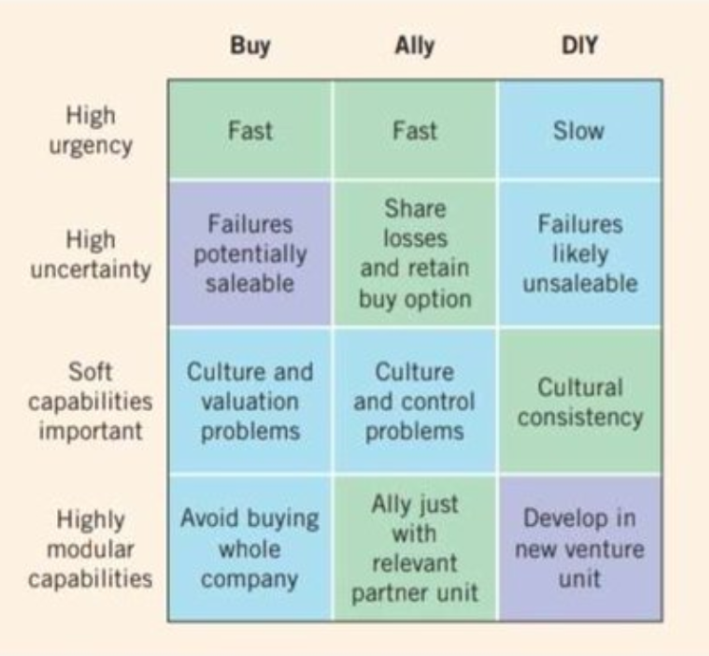
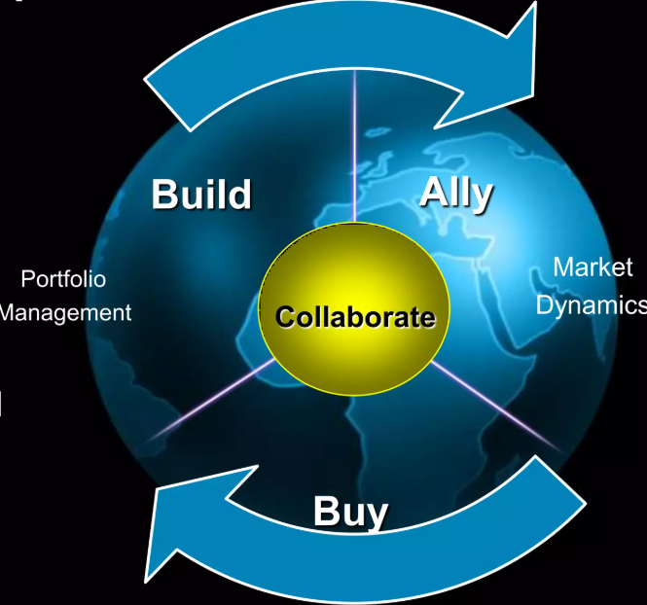
Summary
Four key factors govern
Urgency
Uncertainty
Type of capabilities
Modularity of capabilities
“Companies that use both acquisitions and alliances grow faster than rivals do – as companies like Cisco have amply demonstrated”
HBR, Jan. 2006

Slide 32
Case-to-Theory Integration
Meta demonstrates:
TCE’s rationale (reduced coordination cost).
RDT’s perspective (resource control).
Schilling’s insight: integration capability determines success of sourcing strategy.
Notes:
Teaching Note: Show how classical theory still applies in digital platform era.

Slide 33
Ethical Extension
Prompt: “Should regulators limit acquisitions of small startups by tech giants?”
Yes → protects innovation ecosystem
No → enables capital and scale for startup success
Notes:
Teaching Note: Encourage students to apply analytical, not emotional, reasoning.

Slide 34
Practical Implications for Managers
Managers must:
Evaluate sourcing through both economic and relational lenses.
Prioritize learning in any sourcing mode.
Use sourcing not only for access but for capability growth.

Slide 35
Readings and Preparation for Next Session
Schilling (2022), Chapter 8: Collaboration Strategies
HBR: Strategic Alliances That Work

